Slide 1
System and Cyber Security
L. Budi Handoko, M.Kom. (handoko@dosen.dinus.ac.id /
handoko@dsn.dinus.ac.id)
Dian Nuswantoro University

Slide 2
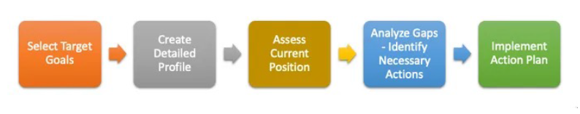
Cyber Security Resilient
Based on PDCA, 5 steps on cyber security resilient

Slide 3
Risk Profile

Slide 4
A cybersecurity maturity model is a systematic framework that aids in the evaluation and enhancement of an organization’s cybersecurity posture. It not only identifies the existing state of security protocols but also provides a roadmap for improvements, incorporating aspects such as data management service and continuous control monitoring.

Slide 5
Benefits
Adopting cybersecurity maturity models offers numerous advantages for organizations. Firstly, they amplify an organization’s security stance by enhancing defense mechanisms, especially when melded with cutting-edge technologies like AI and cybersecurity tools. Additionally, through the insights of a maturity model, threats are markedly reduced as vulnerabilities are identified and guided towards appropriate mitigation.
Maturity models also streamline the process of adhering to standards, making tasks like data governance and lineage compliance more straightforward. In the unfortunate event of a breach, organizations equipped with these models are poised to respond more promptly and efficiently. Moreover, by championing proactive defense measures, they can substantially minimize the financial fallout from potential cyber incidents.

Slide 6
The Implementation Process
Assessing Current State
Before diving into cybersecurity improvements, understanding the current status is crucial. Analyzing the existing cybersecurity infrastructure is a must, and tools like the cybersecurity maturity assessment tool are vital. They pinpoint vulnerabilities, highlight strengths, and identify areas for enhancement.
Setting Security Goals
After assessment, setting realistic goals is essential. These goals, aligned with the organization’s strategy, should be attainable and time-specific, acting as guiding lights for subsequent actions.
Selecting an Appropriate Model
With many models to choose from, it’s vital to select one that fits the organization’s specific needs. For example, the cybersecurity capability model may be suitable for some due to its design and goals.
Developing a Roadmap
This is more than a plan; it’s the organization’s cybersecurity guide. It outlines the journey from the present state to the desired cybersecurity position, providing a clear path for stakeholders to follow.
Implementation of the Roadmap
The implementation phase takes the outlined journey from the roadmap and brings it into action. It involves assigning specific roles, allocating necessary resources, setting time frames, and regularly updating stakeholders. By actively addressing each step and anticipating potential challenges, the organization transforms its strategic vision into tangible cybersecurity improvements.
Measuring and Monitoring Progress
No matter how brilliant a strategy is, its effectiveness lies in execution. Ongoing evaluation keeps the organization aligned. Beyond monitoring, it’s about recalibrating when deviations or challenges arise, ensuring alignment with core goals.

Slide 7
Maturity Models
ISACA – Capability Maturity Model Integration (CMMI)
Cybersecurity Maturity Model Certification (CMMC)
ISO/IEC 21827, System Security Engineering 0 Capability Maturity Model (SSE-CMM)
OWASP Software Assurance Maturity Model (SAMM)
RIMS Risk Maturity Model

Slide 8
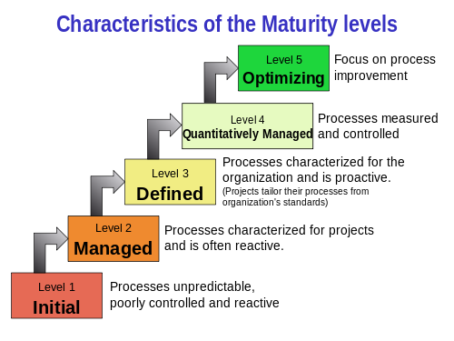

Slide 9
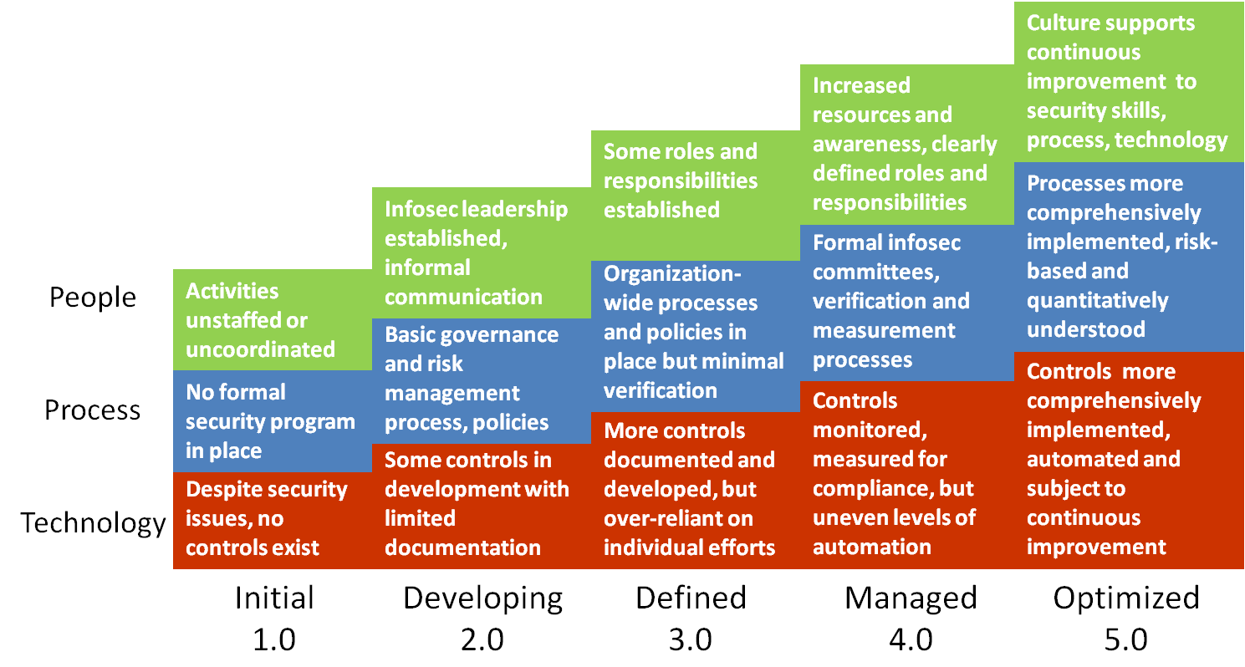

Slide 10
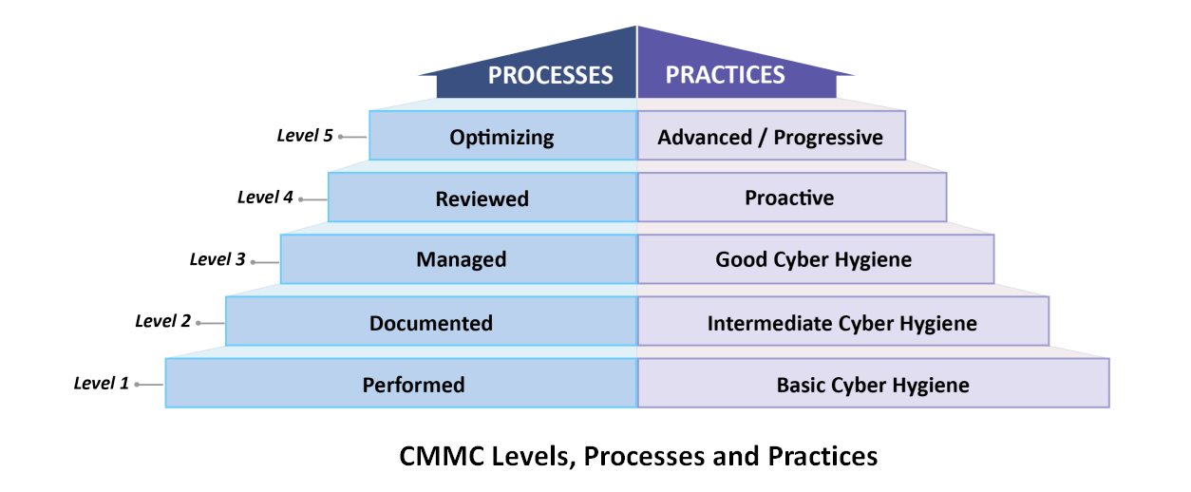

Slide 12
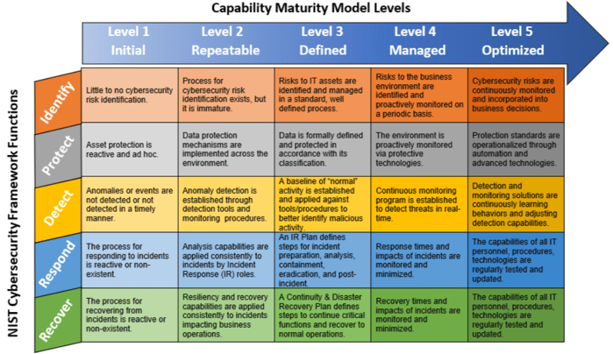

Slide 13
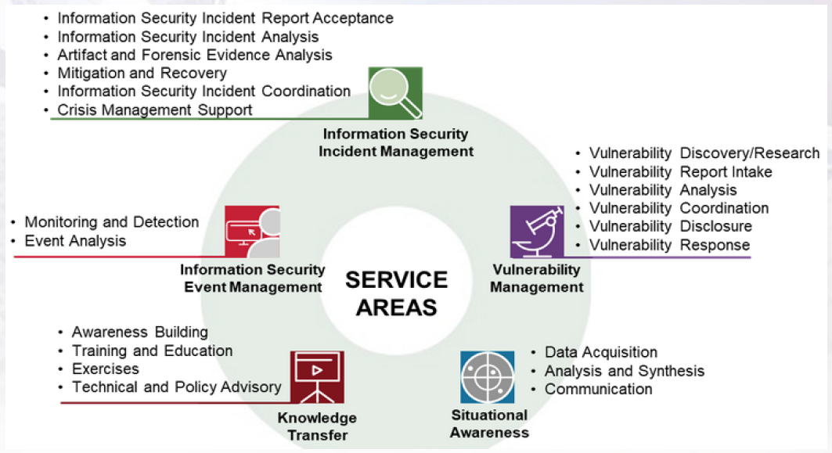
FrameWork CSIRT (Framework 2.1)

Slide 15
Computer Security Insiden Response Team (CSIRT)
Menjaga aset sistem Informasi dari ancaman, dan gangguan Keamanan siber. Setiap Organisasi harus melakukan Pendataan dan Pengklasifikasian Prioritas Aset mulai dari yang biasa hingga Kritikal
Bila insiden terjadi, maka institusi bisa bergerak dengan cepat untuk merespon dan menangani insiden secara efektif dengan memimalisasi kerusakan dan mengurangi biaya recovery.
Mengembalikan Sistem ke keadaan normal dengan cepat dan tepat.
Menekan dan mengurangi resiko Dampak insiden agar tidak berdampak luas, dan meminimalkan kerugian
Mencegah insiden serupa terulang di masa mendatang
Menjaga Reputasi Instansi atau Organisasi.
Dengan Penanganan Insiden yang cepat, tepat dan terukur dapat menjaga kepercayan publik pada instansi / organisasi.
Aset
Hardware
Software
Informasi
Infra-struktur
Sumber Daya Manusia
Pihak Ketiga
Acuan Kerja dan SOP : RFC 2350

Slide 16

Any Question ?
Anything to discuss ?

Slide 17


